Slide 1
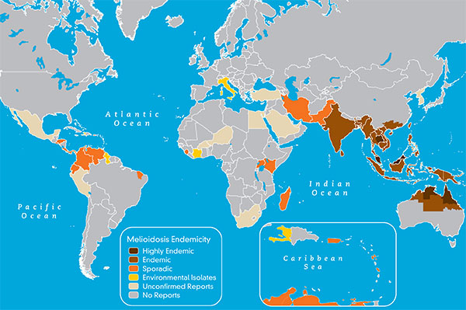
Melioidosis
Caused by the gram negative bacillus Burkholderia pseudomallei and spread through contaminated soil and water of tropical and subtropical regions
Symptoms: “Great Mimicker” ; symptoms vary from in-apparent to chronic to fatal septicemia
Diagnosis: Culture and/or serodiagnostic assay
Culture: Gold Standard for detection; low sensitivity (55%), not in every sample or sample type
PCR- sample must be previously amplified (ex- culture), not in routine use
IHA- Not used for diagnostics- not standardized worldwide with varying cutoff values; tool for measuring patient response to treatment
Limits of serodiagnostics in endemic areas- background seropositivity in a healthy population is high; Although a greater tool in travelers
Treatment: antibiotic treatment; Ceftazidime for 10-14 days following Trimethoprim-sulphamethoxazole for 3-6 months
Fig.1- Endemicity of Melioidosis (CDC)
Notes:
→ Melioidosis is the disease in which our developing diagnostic assay and subsequent analyses, which you’ll see later, revolves around
This disease is caused by the gram negative bacillus, Burkholderia pseudomallei, a soil bacterium which can be spread to humans by contaminated soil an water
This disease is prevalent in tropical and subtropical areas of the world (SEE MAP)
The symptoms for this disease are widely varied, hence the name for the “great mimicker”. Disease symptoms range from in-apparent, flu like, chronic illness, or fatal septicemia
The diagnosis, which is where our project fits in, is subject to two main methods- both with great limitations.
If there is a suspected patient, culturing the organism is the most effective and definitive diagnosis. In endemic countries such as Thailand and Australia, culturing is easy, cheap and translatable across countries.
Culturing can be difficult due to the sample type and presence. It is common for a patient to be diseased and not be able to culture from a sample type. In addition, not all sample types have the bacteria present. Sensitivity is roughly 55%
Following a culture positive sample, a secondary test such as a lateral flow assay or PCR must be completed.
In the case of PCR, the sample MUST have been previously amplified (ex- culture) in order to produce a result.
The other common assay in diagnosing Melioidosis is an Indirect Hemagglutination assay (IHA) in which a whole cell lysate or broken up bacterial cells are presented with patient red blood cells. If the patient’s red blood cells clump together, this shows that the patient has antibodies to the bacteria.
The weakeness to this assay as a lack of standardization across different countries. Even more so, this assay cannot determine whether a patient has been previously infected or currently infected. At our collaborators institute, this assay is used to monitor a patient’s response to treatment
- Treatment is extensive..up to 6 months
Sources:
image: https://www.cdc.gov/melioidosis/prevention/index.html
Melioidosis: a clinical review : https://watermark.silverchair.com/ldr007.pdf?token=AQECAHi208BE49Ooan9kkhW_Ercy7Dm3ZL_9Cf3qfKAc485ysgAAAi4wggIqBgkqhkiG9w0BBwagggIbMIICFwIBADCCAhAGCSqGSIb3DQEHATAeBglghkgBZQMEAS4wEQQMHH4vK2DaY1t9V0JqAgEQgIIB4Tjjp8bIYTBk9GqbZO_6xs2e3nFE2gFM00E9dRRELXC7qnaRtG_Sqb3X39yDHuqfNl5I_iK1zPNjxEQ-25kk0_0tDZzI1hvXRe6pQsC_Vxt3FduJ7Jbt8PJBtdmsOAv8r7SwvCkV4XSKBko6AL6xTKIvSdwOlPK6ItBwECDhMHseQ19xii4XgZTwJxJY3YpW0SU6LaNfvG5-qy54e1MaO2j4c-lC_uBb36-7ZzCflarGvh5wxyAcVme880BT3WUbhpGpBBnKigQjdEPfK8SeBTFlG9Wh5ut52MzHv4GXiRInhYPSh0iSpYfN5A6zKIDw4I4mzEC6GZ_LIgzMzw9ZvOhXHE6ilHOGIFG147N4kGkOclI6-cBWy6OwZ_EDKsQmw6KthvJPlLnUYZs5WZEJX01Q6UCvZRvjQU1P2FJHfWhhJuVneJOZjLQBP3Hy0KKthAj_TPlUtX5pQWy6GcEwPo9634PzzuIinxYQBJDznad6_RYiitiKYTsBEVYvbKuYKmxoafnmZNEfZLGCPuKkCbu2fX7DgOMCUMHy1V_TJu47KusbgPBcyaL7ruDsypvh9VUmQpFg3LdNTc7l6SLVWR8AlJB7QDcC1jvumAsDM6qBEtuMXvTG8rNMqHyo2FSMw8Y
Dr. Amy Vogler’s PMI SA Biosafety Training Initial 20170328

Slide 2
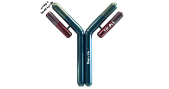
Goal: develop an assay that improves sensitivity and specificity over current assays (IHA)
Approach: develop a MAGPIX multiplex assay to detect B. pseudomallei infection using proteins
MAGPIX Technology
Indirectly detecting pathogen in
A host through hosts antibody response
Bind protein to a bead
Bead contains unique composition of red & green fluorophores
Up to 50 different beads
Bind different proteins to different beads
Mix up all the beads and put into one well
Add primary antibody (patient serum) to well
Add detection antibody bound to fluorescer for detection
Measurements
Presence: Count
Intensity: Median
A
Similarity to an ELISA (Enzyme Linked Immunosorbent Assay)
Bind one protein per well
Add primary antibody (patient serum)
Add secondary antibody bound to HRP (enzyme) for detection
Base our result off one protein per well
Notes:
Also remember that pseudomallei, like any other bacteria, is made up of proteins, in which some of those are antigenic, OR cause us to be sick, and w can find those and determine disease (specific)
Before I talk about the MAGPix technology, I want to explain how similar this assay is to an indirect ELISA. If you are familiar with the ELISA methodology,yay! I will quickly walk though the basics first.
An ELISA is generally conducted in a 96 well plate in which a substrate of some sort (protein, peptide, etc) is bound to the bottom of the well. For this sake, I am using protein as our substrate.
In the ELISA, there is one protein per well.
Add a primary antibody (this can be patient serum)
Detect with a secondary antibody bound to an enzyme
So with an ELISA we are only testing ONE protein per well and basing our results off one protein. For detecting Melioidosis, the chances of finding ONE definitive protein that is NOT cross reactive is pretty much impossible.
If you were to test more than one protein in an ELISA, this would take more supplies, time, and money.
Now transitioning over to the MAGPix assay, we are doing the same thing here which is indirectly detecting the pathogen in a host through their own antibody response. The major difference here is MULTI PLEX and some technical things.
The first thing we do is bind a protein to a bead region. In the MAGPix Technology, each bead region has a unique composition of red and green flourophores and this accumulates to a total of 50 bead regions to use.
We bind different proteins to different beads,
For example, protein A here is bound to this region, but protein B can be bound to this other region
Once we have all our bead regions we want bound to protein, we mix all the beads together in a master mix and put it into each well of a 96-well plate
Add primary antibody (patient serum) to the wells
Add detection antibody bound to biotin
So what is happening in each well is there are X number of protein bound to beads and interacting with one patient serum. Remember that in an ELISA you can only detect with one protein at a time and here we are detecting up to 50 proteins in a well. Here we are basing our diagnosis off a pattern of responses to many antigens rather than one data point off one antigen
After this process we obtain a few different results- two important ones here are presence and intensity
Presence: Was the bead with the protein present? Count
Intensity: How strongly did the patient antibody react and subsequently product a lot of detection. Median

Slide 3
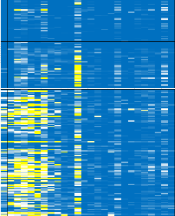
Goal: develop an assay that improves sensitivity and specificity over current assays (IHA)
Approach: develop a MAGPIX multiplex assay to detect B. pseudomallei infection
BurkPx Assay
A
Consists of 25 beads
21 B. pseudomallei proteins
Additional 4 controls
Data set includes:
Over 18 CSV files
over 500 patients screened for a retrospective analysis (Non-Melioid and Melioid)
Isotypes: IgM, IgG
Collaborators are currently running this assay in the clinic
2-3 CSV files/week
All the data feeds in to a multivariate model in order to optimize the assay and diagnostics
Assay/Model optimization
Notes:
-Our current assay includes 25 beads consisting of 21 beads bound to 21 different b.pseudomallei proteins and an additional 4 controls
Our current data set is quite large and we are still collecting data
Here at NAU
18 CSV files
Screened over 500 patients
At MSHR
Prospective analysis
2-3 CSV files a week
All the data feeds into a multivariate model in order to learn how to downselect antigens, determine disease vs. non disease, and optimize the methodology. In order to make this process smooth, we need a quick way to organize the data for model analysis

Slide 4
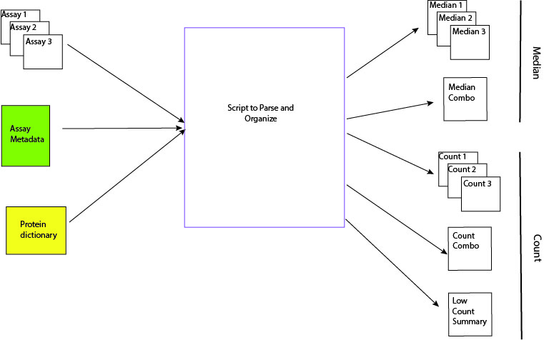
Parse & Organize for analyses
A
Notes:
Starting from the left….
3 Assay files: these are results files and will be excel CSV files directly from the machine.
1 Assay Metadata file: This will be a plain text file that contains the assay metadata for all the runs. You will use this file to add metadata columns to the runs. Metadata includes Isotype (IgG,IgM), and Disease state (melioid, non-melioid)
1 Protein dictionary file: This will be a plain text file containing two columns of protein names. You will use this file to rename the proteins and re-arrange the order in the files
The middle is the space in which the script will work its magic!
On the right….
There will be a sum of 5 different output files
For the Median data, the script will produce three Median tab delimited files containing that particular run’s data. You will do the exact same for Count data.
For Median data, you will also combine all the assay data into one combo file. You will do the same for Count data
For the count data, you will use the Combo file to output a “Low Count’” Summary file. This file will contain a the proteins that had low bead counts, and the number of instances the count occurred.

Slide 5
Glance at Input and Output format
Simplified Input Median Table
Simplified Output Median Table

Slide 6
Walk through a csv file and show documents for project

